Slide 1


Rescue Me
Screen Views

Slide 2
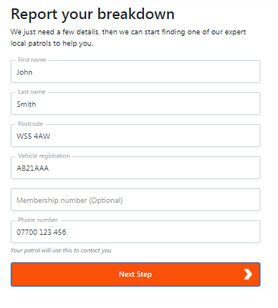
Report Your Breakdown

Slide 3
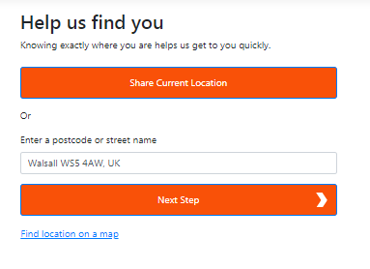
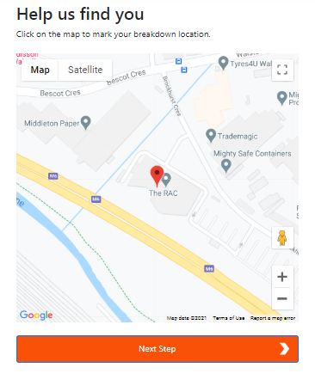
Help Us Find You

Slide 4
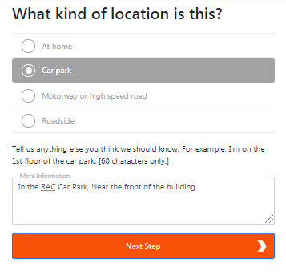
What Kind of Location is This?

Slide 5
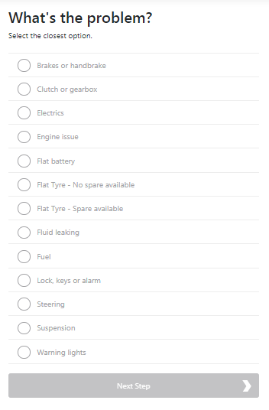
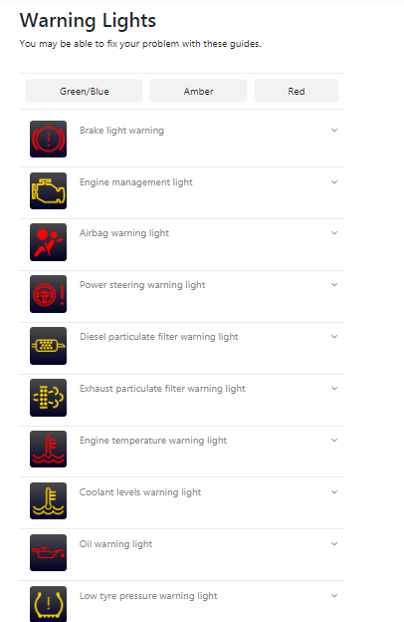
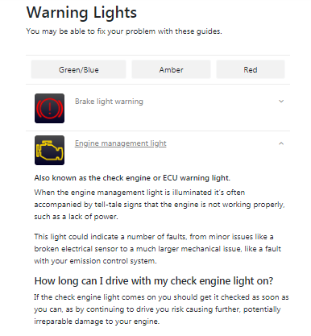
How it Works – Symptom Selection

Slide 6
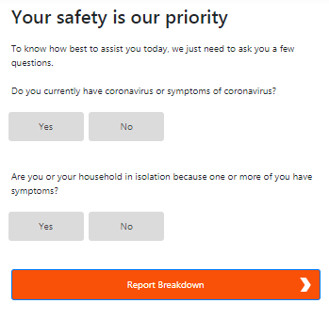
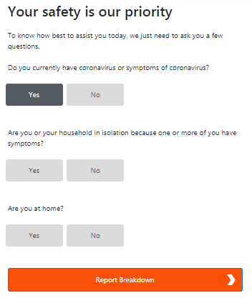
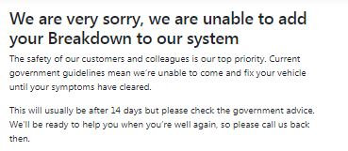
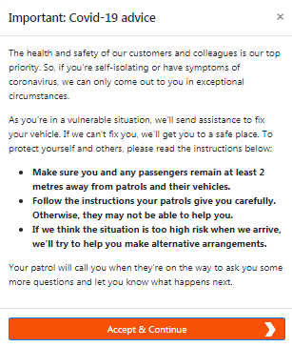
Your Safety is Our Priority
1
2
If customer selects that they have symptoms or a family member has symptoms of coronavirus they are presented with an additional option (Are you at home?)
If customer is at home message 1 is displayed
If customer is not at home message 2 is displayed

Slide 7
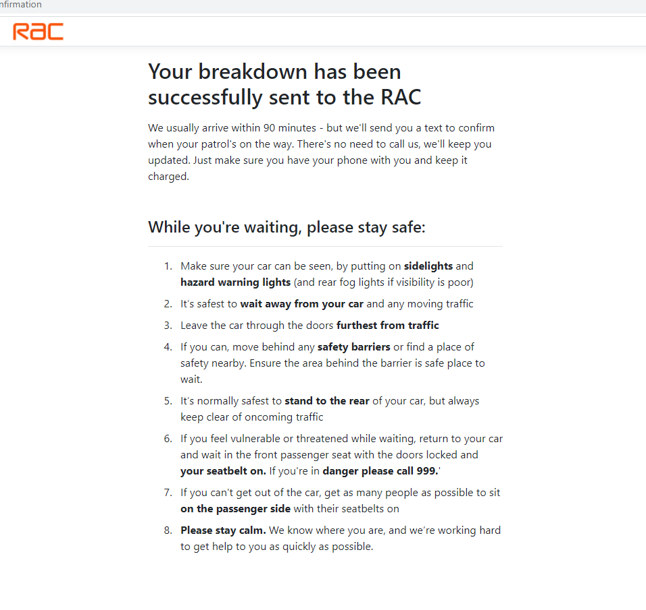
Breakdown Confirmation Screen

