Slide 1
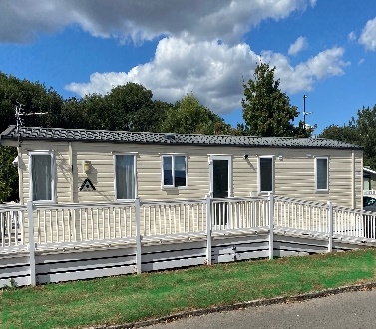
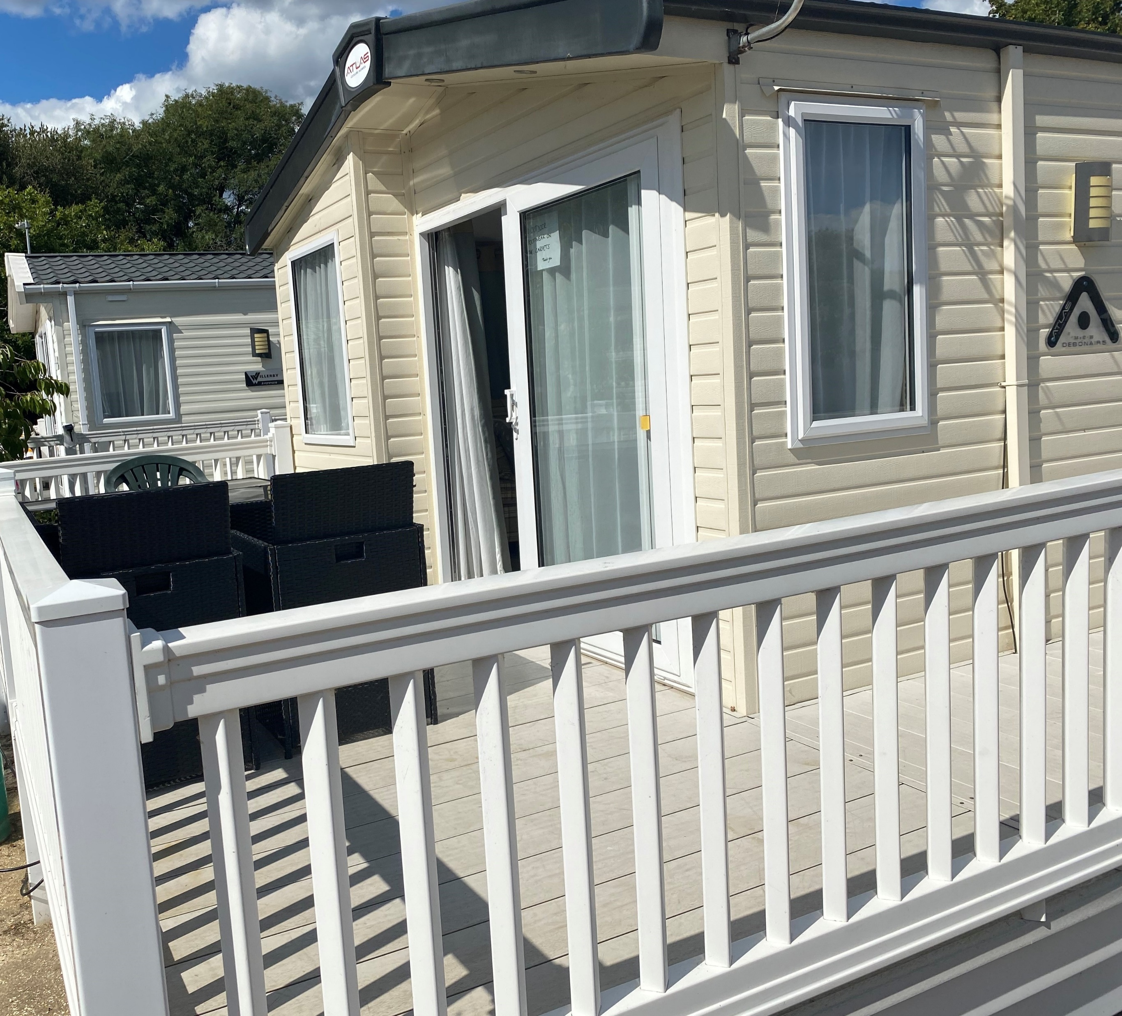
Surrey Police Federation Rest Home at Shorefield Country Park, Milford-on-Sea
Officers and their families requiring rest and relaxation in a stress-free environment following injury, illness
or trauma may have free use of this property. When not being used any member who contributes to
the Federation or in the Group Insurance can hire it for a holiday.
Facilities
Tennis and football courts
Club with Family entertainment
Squirrel Squad and woofs workshop
Swimming Pools (indoor/outdoor)
Fitness centre
Reflections Elemis Day Spa*
Jacuzzi, steam room, sauna
Supermarket and launderette*
Children’s outdoor play areas
Amusements* and Crazy Golf*
*charges apply
5 star holiday park
3 miles from the
New Forest National Park and a short walk to the sea
Sleeps 8
3 bedrooms
Terrestrial TV
Wi-fi
Outdoor seating for up to 8 people
Microwave, oven + fridge
Fully equipped kitchen
All clean bedding provided
Entertainment passes included
Pets allowed at additional price
Nearby attractions
Peppa Pig World at Paultons Park
Hurst Castle
Sammy Miller Motorcycle Museum
Appetite for Adventure
Isle of Wight – ferry from Keyhaven
Highcliffe Castle
RSPB Nature Reserves
Exbury Gardens & steam railway
Sherborne Castle
Beaulieu
New Forest activities including:
Canoe tours, kayak tours and hire, archery, Battlefield LIVE, bike hire, ropes and bushcraft
Horse riding stables
Nature trails
Cycle routes
Fishing
Yachting
Surf schools
Golf course
Scan the QR code to check 2023 availability, or contact Surrey Police Federation Office on:
Tel; 01372 352165
Email: shorefield@polfed.org
Federation prices Monday – Friday or Friday -Monday
2022 Prices 50% off Shorefield webite prices
February to Easter £250
Easter Holidays £350
May half term £300
Easter to June £250
July £350
August £350
September to October £250
October Half term £300
November to December £200

